Slide 1
1965 Double LODD Omaha (NE) FD
June 4, 1965
Death by Smoke Inhalation
Multiple Sources – newspapers.com

Slide 2
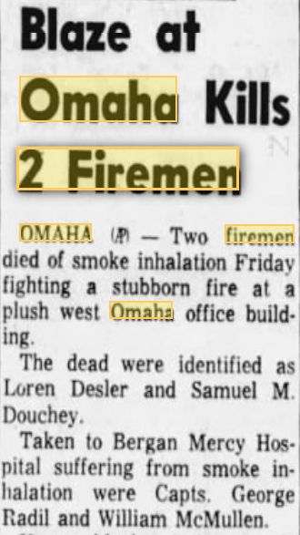
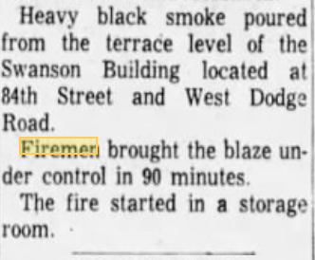

Slide 3
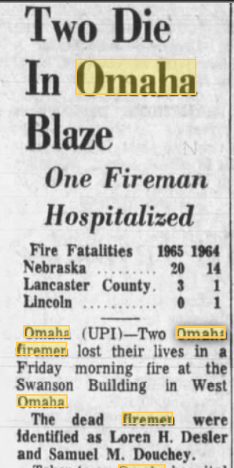
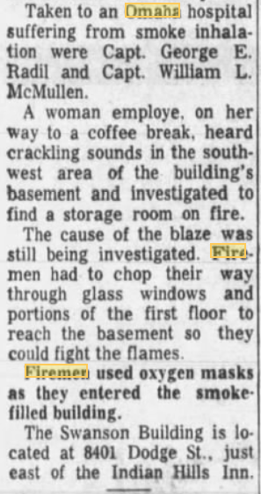

Slide 4
