Slide 1
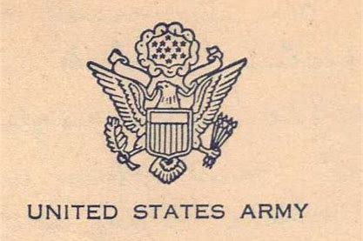
1941 Quintuple LODD U.S. Army FD (Sitka, AK)
October 12, 1941
Dynamite Explosion
Various Sources via newspapers.com

Slide 2
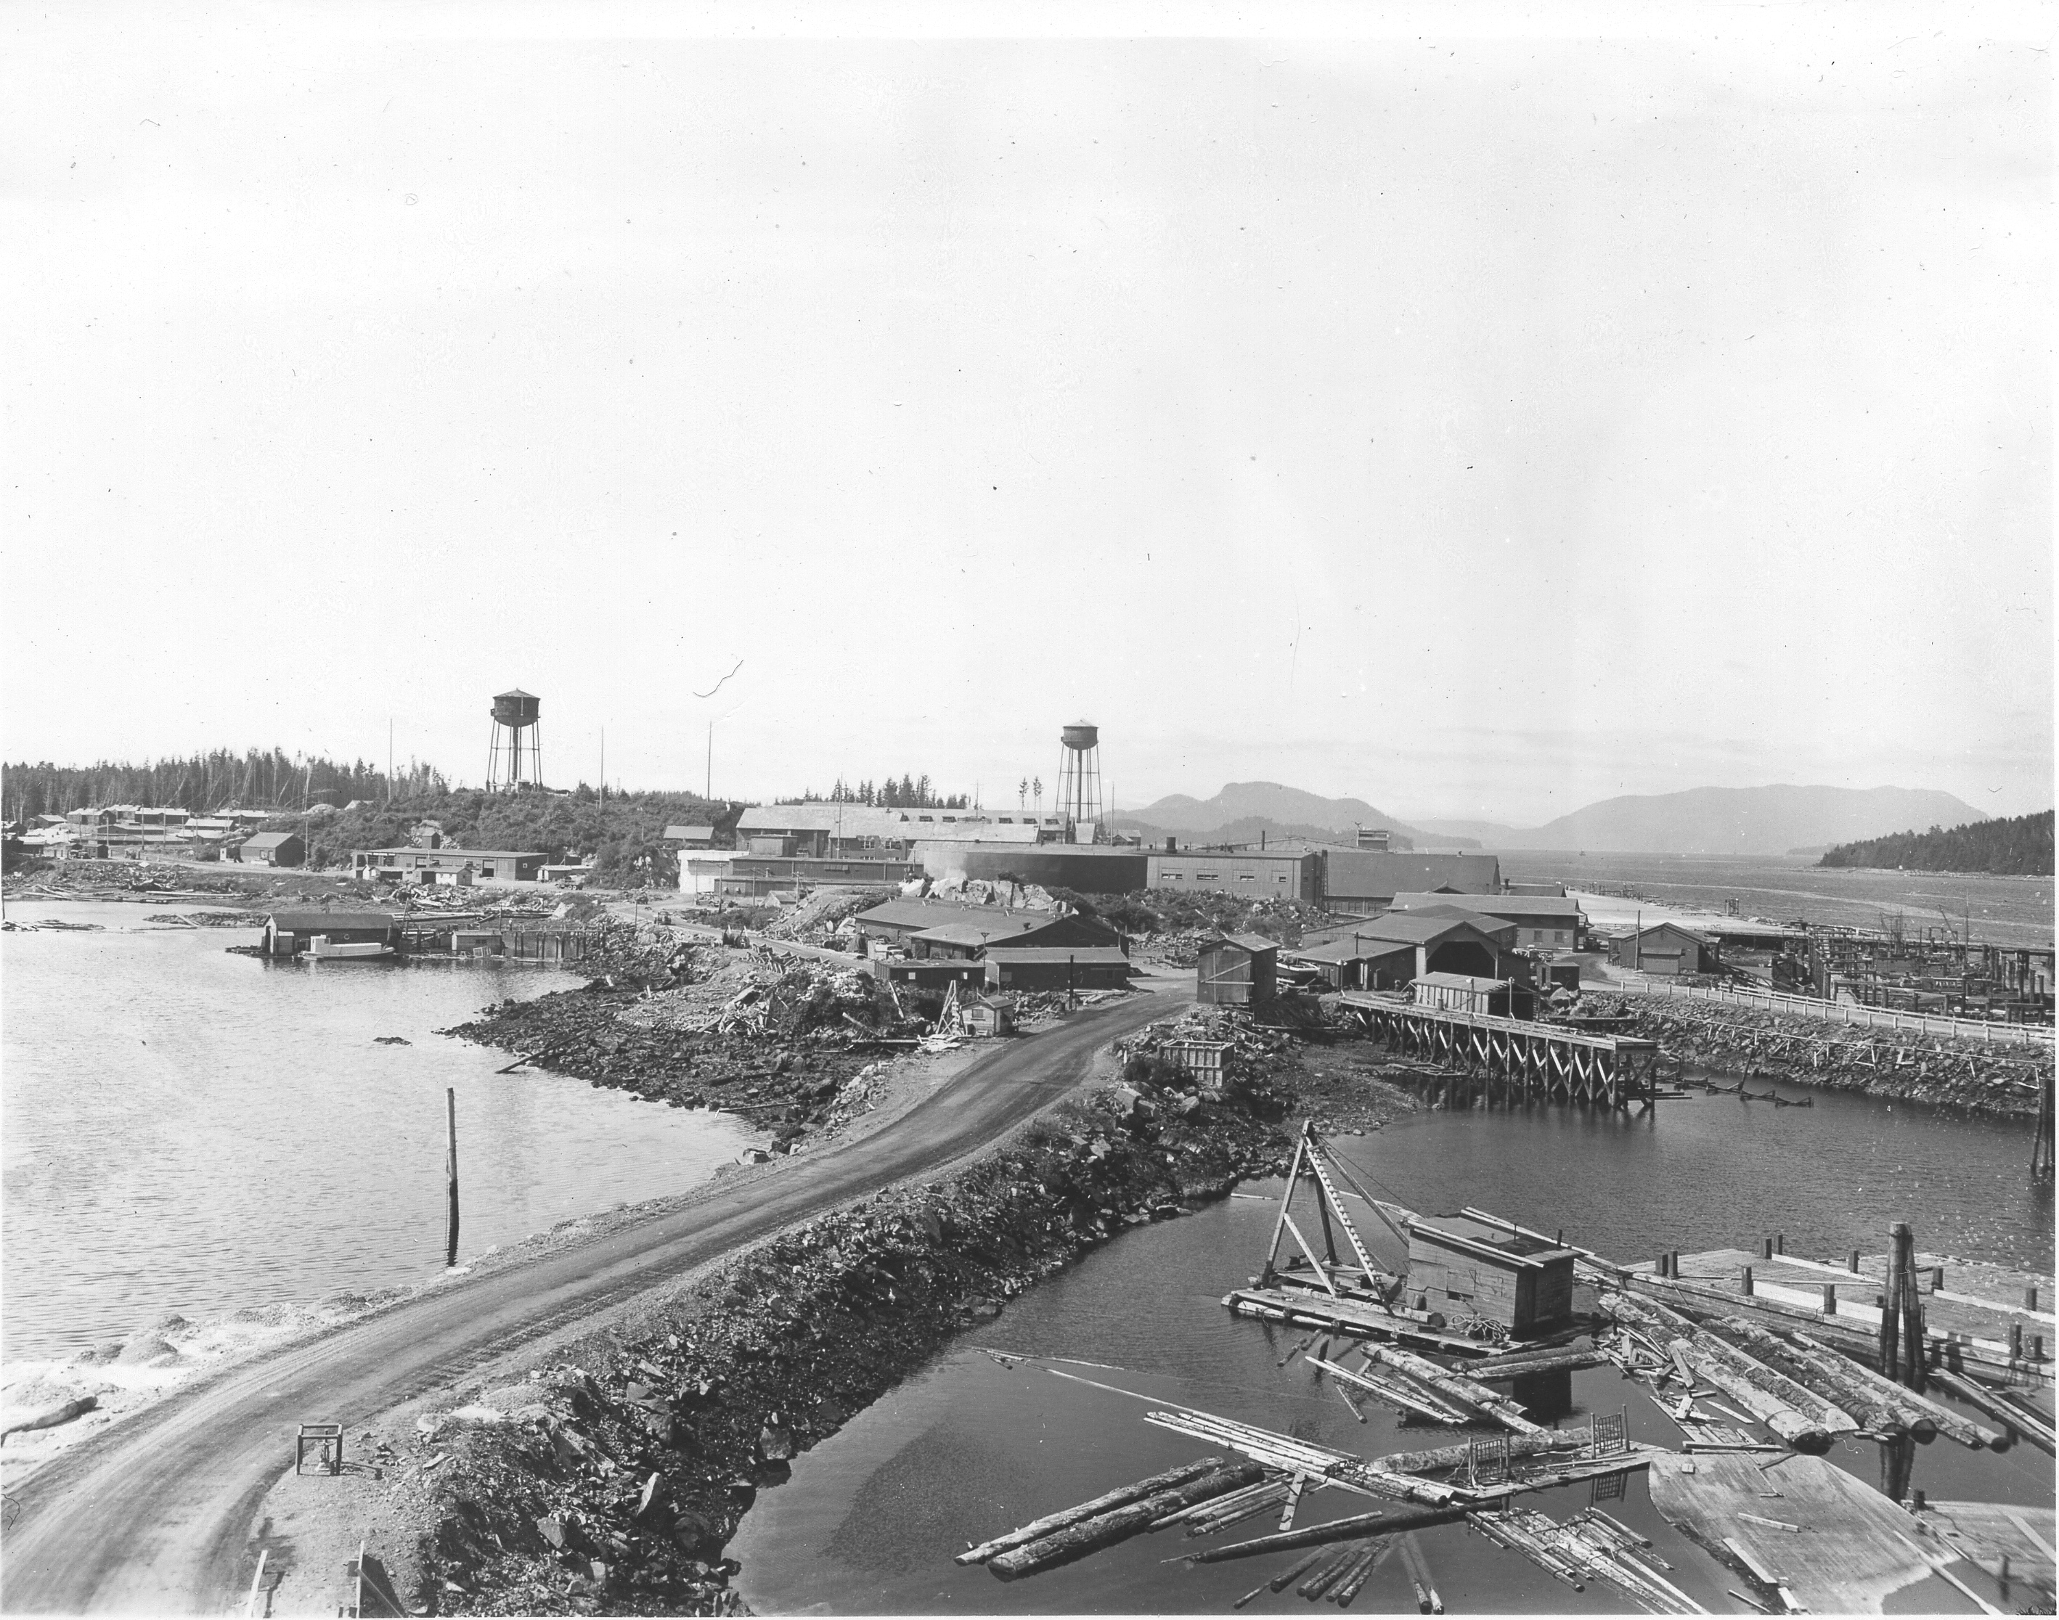
Sitka, Alaska in World War II
Sitka Naval Air Station was the only defense installation in the North Pacific when WWII began.
Sitka was one of the last Coast Artillery Stations in North America.
U.S. Army decided to blast, flatten & connect the smaller islands.
Site was staffed by thousands of Army troops.
Source: http://www.sitkamaritime.org/world-war-ii-and-japonski-island.html

Slide 3
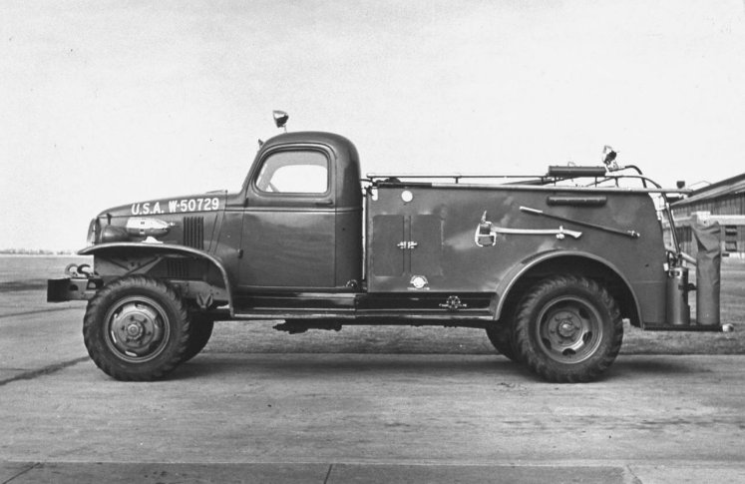
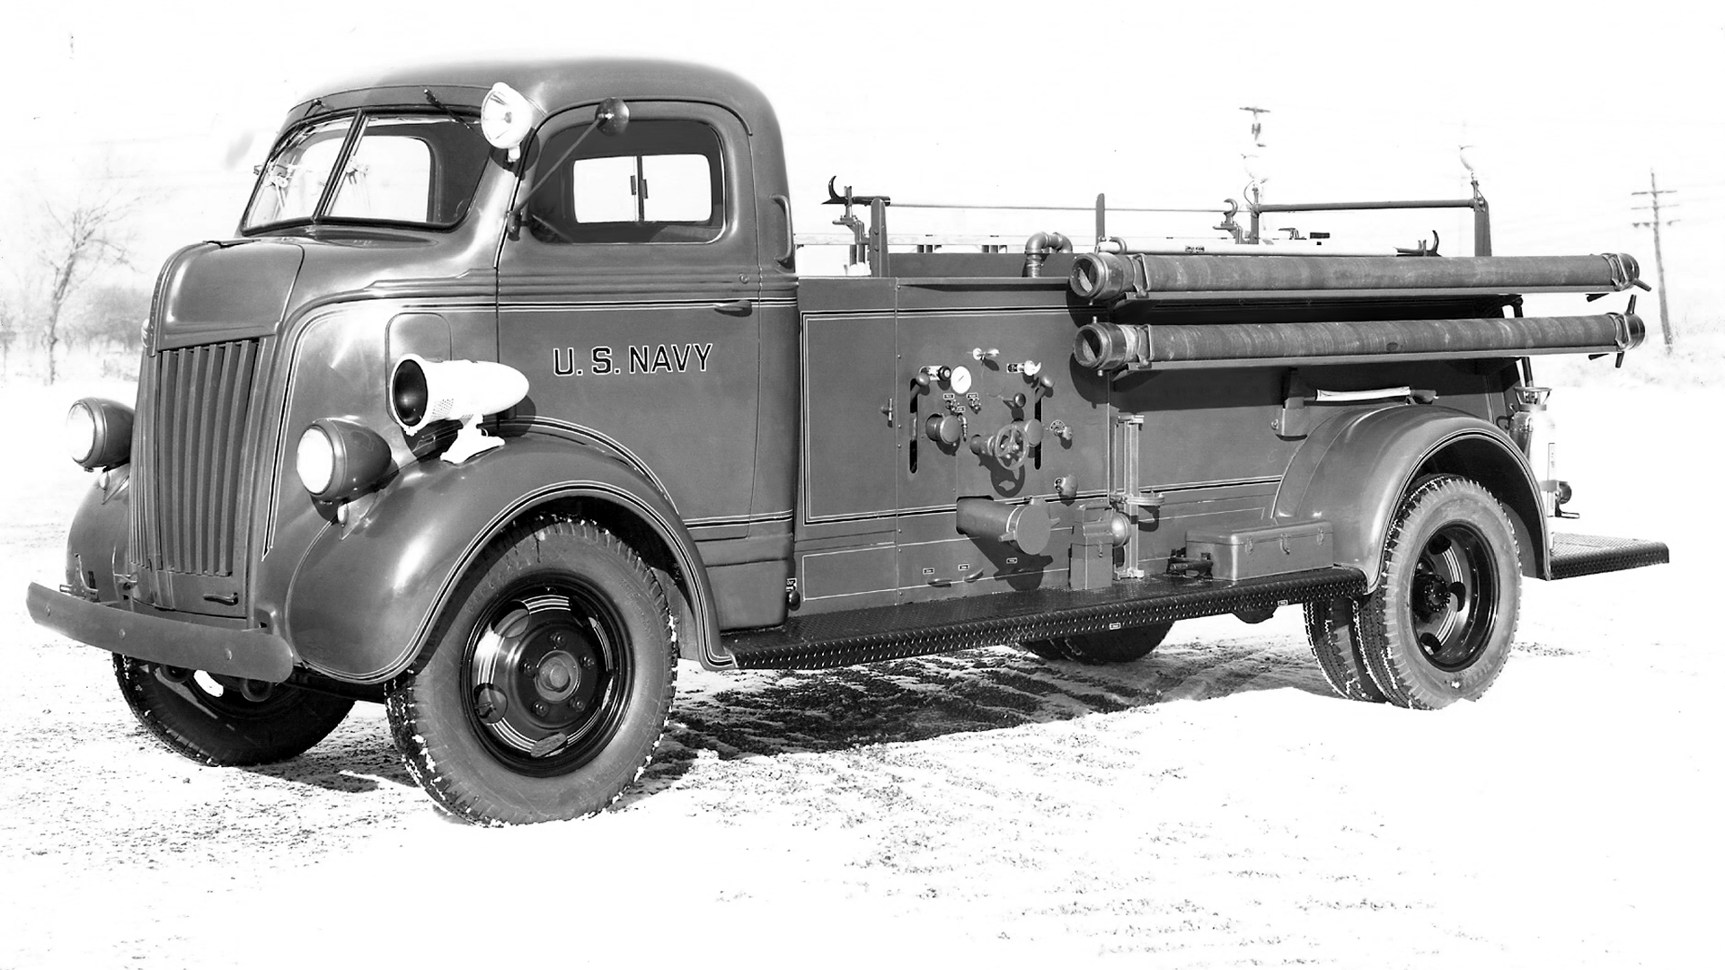
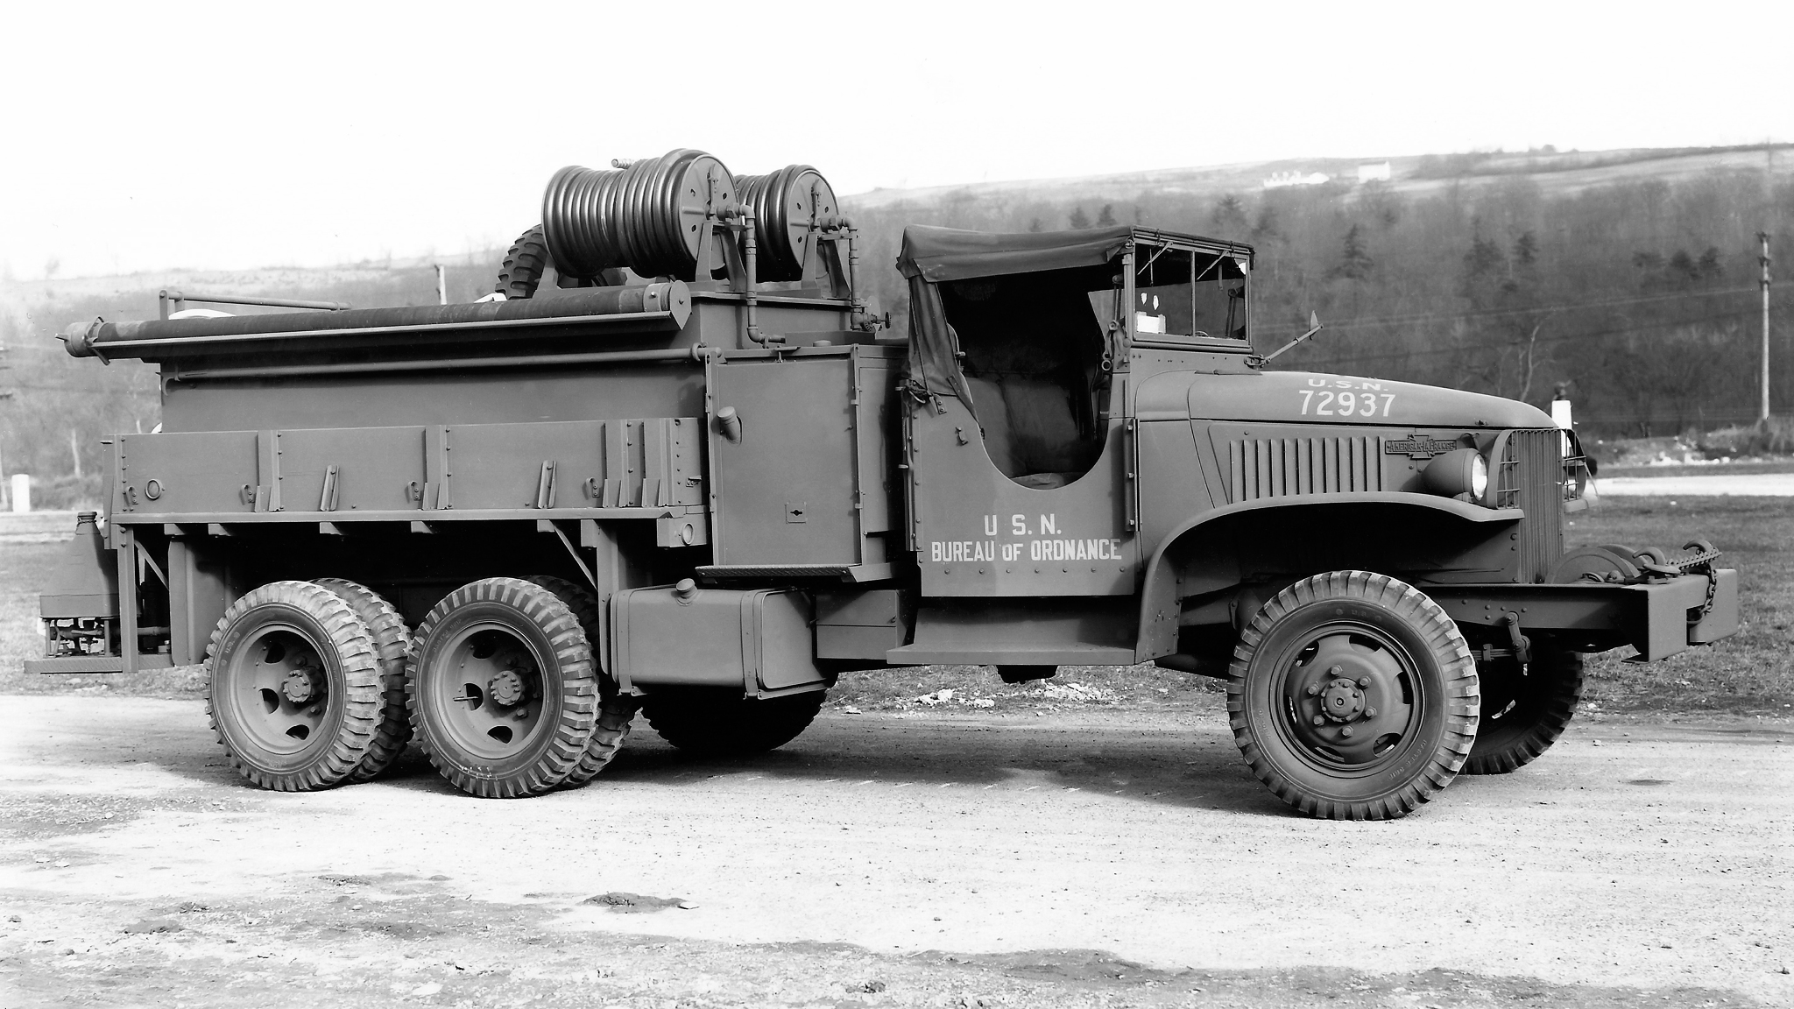
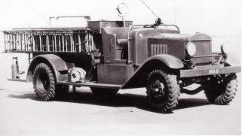
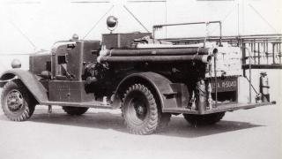
WWII Fire Apparatus circa 1941
Images from: www.firetrucks-atwar.com

Slide 4
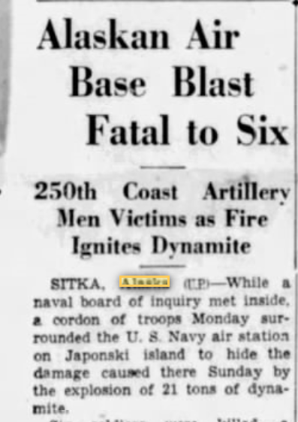
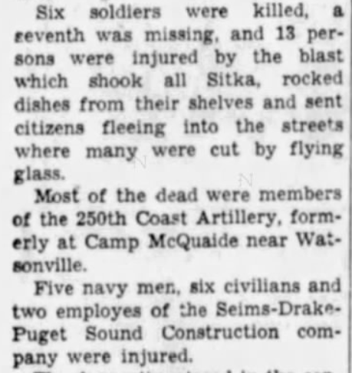
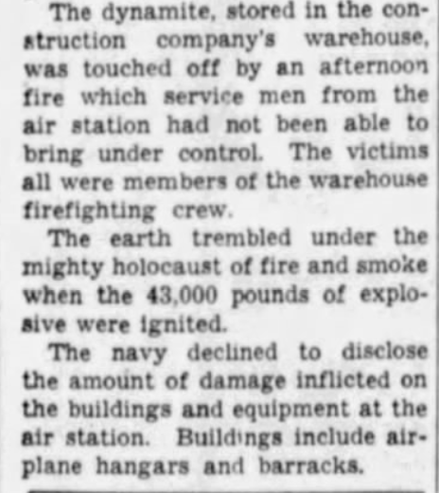

Slide 5
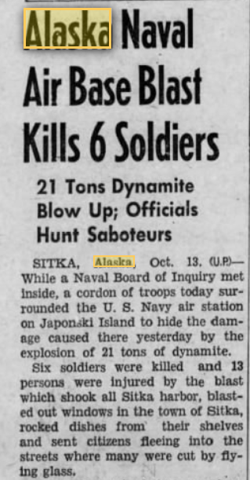
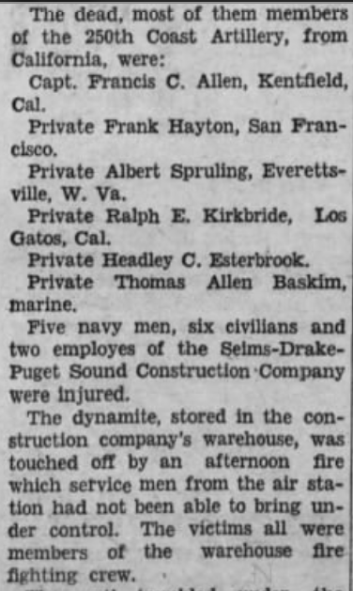
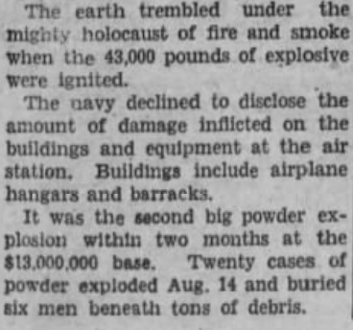

Slide 6
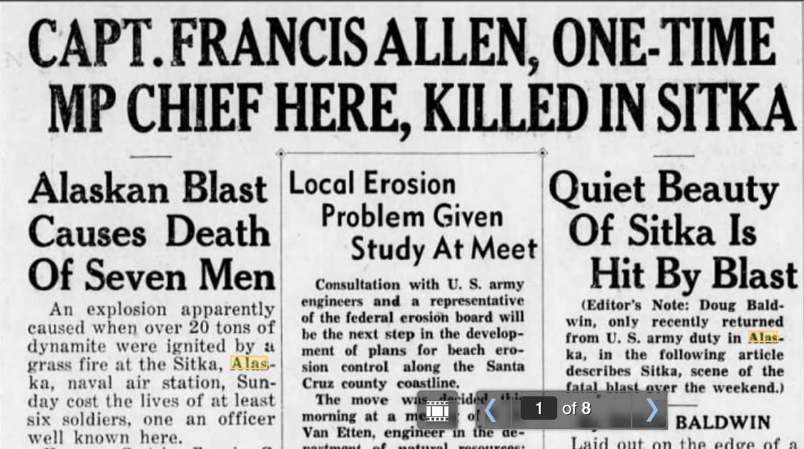
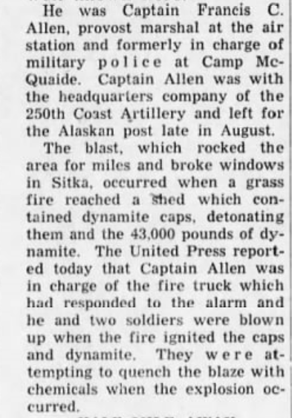

Slide 7
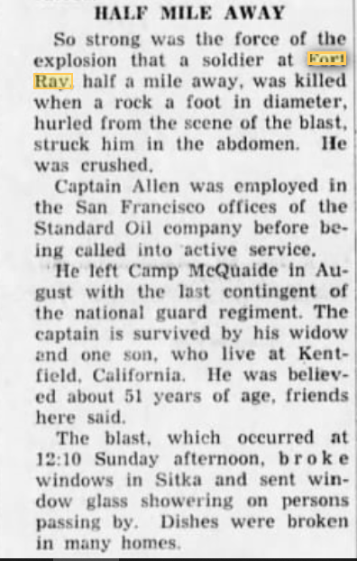
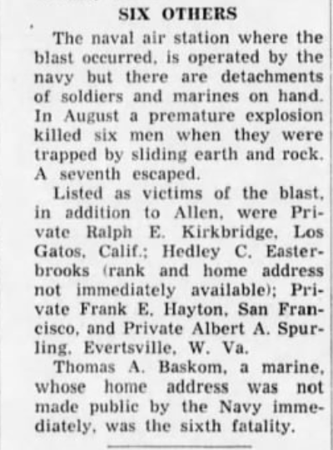

Slide 8
