Slide 1

1960 Triple LODD
Louisville (KY) FD
December 17, 1960
Death by Smoke Inhalation
Multiple Sources – newspapers.com
supportingheroes.org

Slide 2
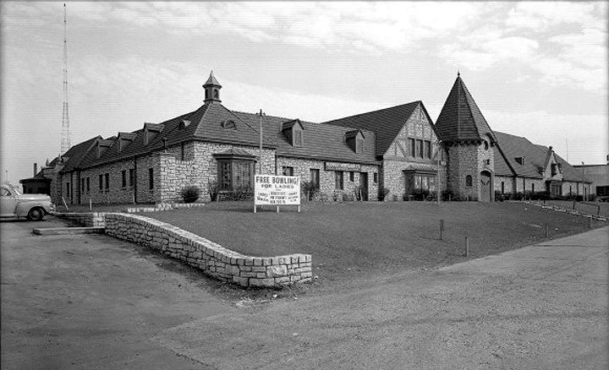
2545 S. Third
2 stories w/attic
40 lane bowling alley
Restaurant
Coffee shop
Night club
Bar
Mortgage company office
Historiclouisville.weebly.com

Slide 3
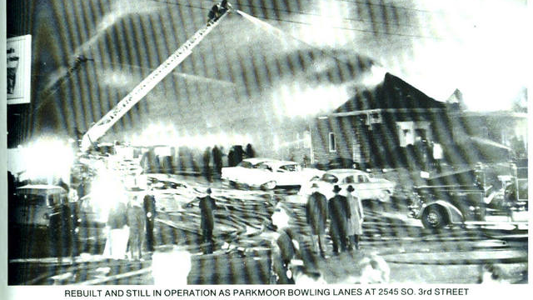
Louisville, KY
December 17, 1960
Fire breaks out at 1925 hrs. on the grill at the Parkmoor Recreation Center, 2545 S. Third.
Owner fails in attempt to extinguish fire before calling LFD. First alarm at 1926 hrs.
“Only a little smoke was visible from the roof upon arrival…”
Additional alarms sounded at 1932 hrs., 1938 hrs., with three special alarms sounded between 1938 hrs. and 2003 hrs.
Fire was contained within an hour by 14 of 17 engines, 2 of 3 ladders, and 2 of 4 quads in LFD’s frontline companies.

Slide 4
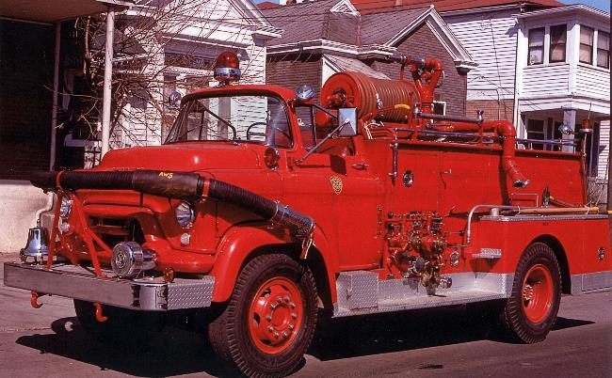
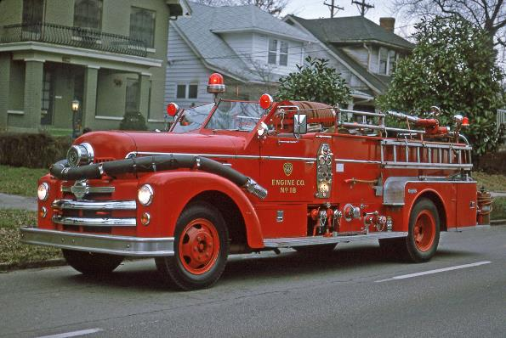

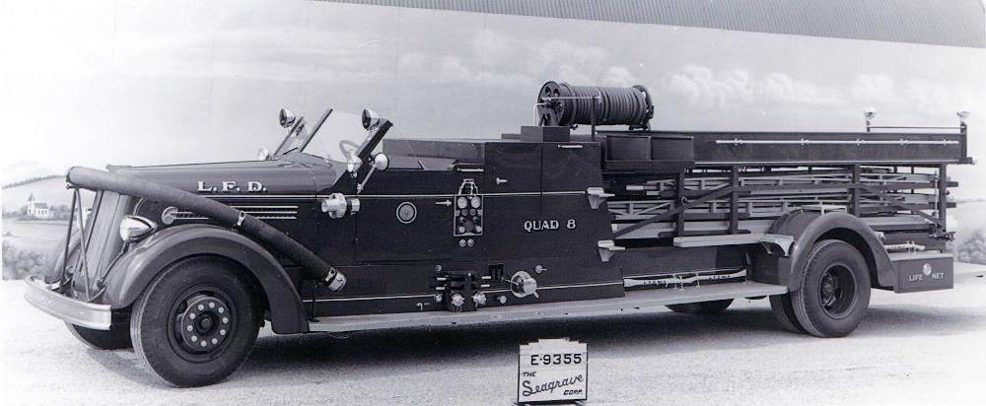
1st Alarm
Engines 16 and 18, Quad 8, Battalion 3*
*Captain Buren was Battalion 3
*Sergeant Wilson was Battalion 3 Aide
(Both were scheduled to be off but were working for others.)
Engine 16
Engine 18
3 special alarms called
Quad 8
(Firefighter Pryor’s Company)
Photos, alarm information and member company assignments courtesy Kent Parrish
www.kentuckyfiretrucks.com

Slide 5
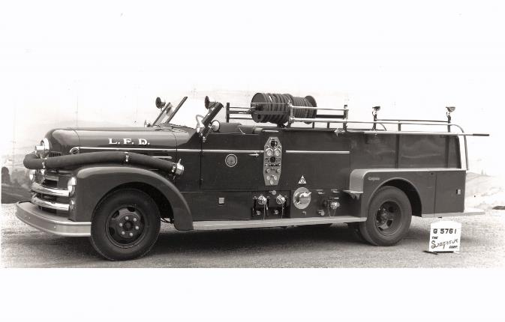
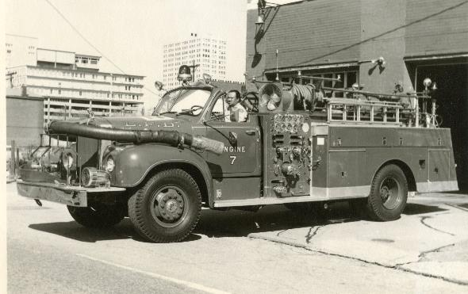
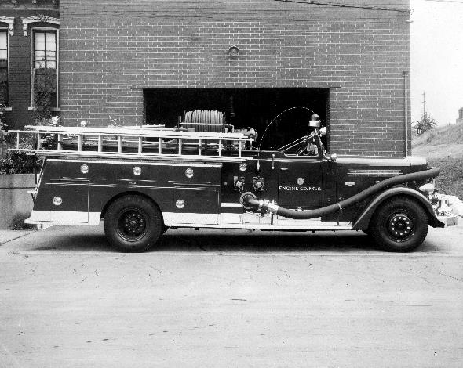
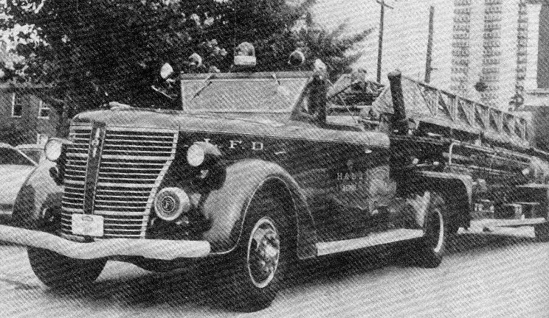
2nd Alarm
Engines 6, 7, and 8, Truck 3, Battalion 2
Photos, alarm information and member company assignments courtesy Kent Parrish
www.kentuckyfiretrucks.com
Engine 6
Engine 7
Engine 8
Truck 3
(Sgt. Wilson’s normal assigned company)

Slide 6
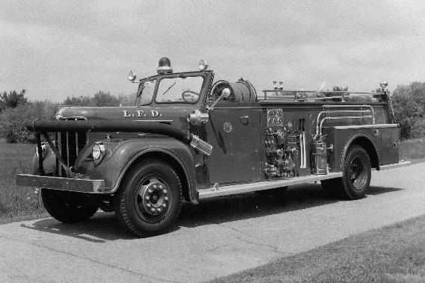
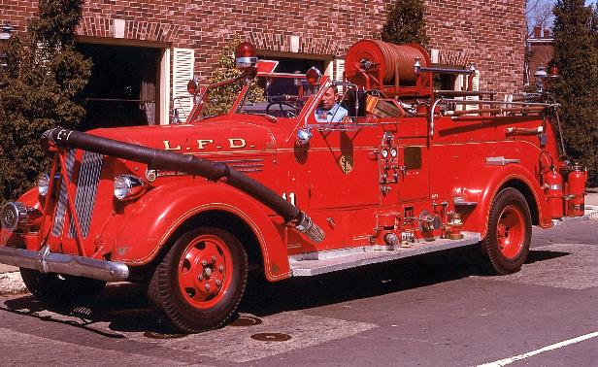
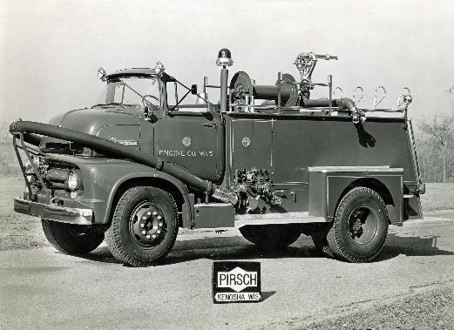
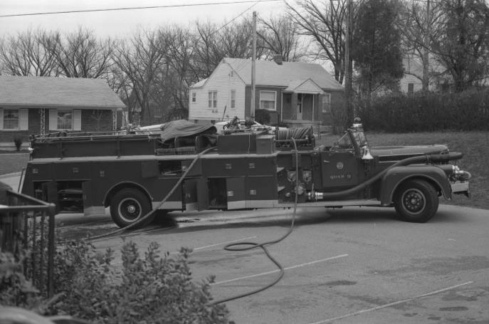
3rd Alarm
Engines 9, 1, and 5, Quad 9
Battalion 1
Engine 9
Engine 1
Engine 5
Quad 9
Photos, alarm information and member company assignments courtesy Kent Parrish
www.kentuckyfiretrucks.com

Slide 7
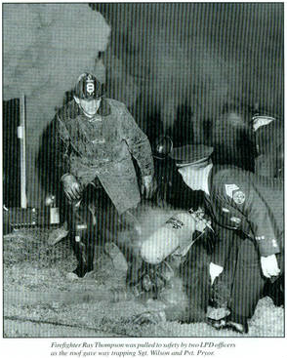
A backdraft occurred, overcoming Captain Buren and trapping Sergeant Wilson and Firefighter Pryor.
6 other firefighters were injured.
Captain Buren died on the way to the hospital at 2010 hrs.
Sergeant Wilson was found at 2215 hrs.
Firefighter Pryor was found at 0200 the next day.
The fire was believed to have extended from the grill into a large attic space where it built up an excessive amount of heat and became ventilation limited.

Slide 8
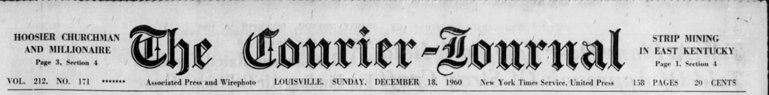
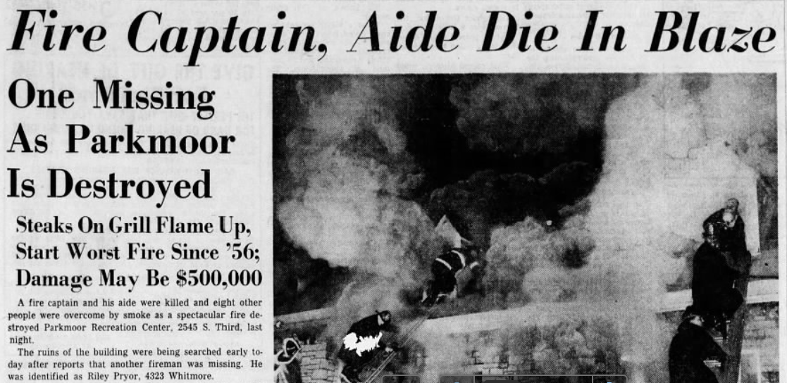

Slide 9
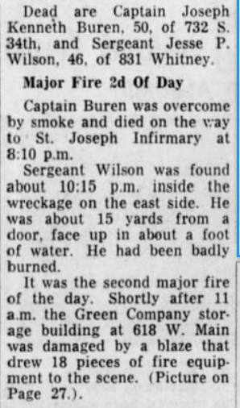
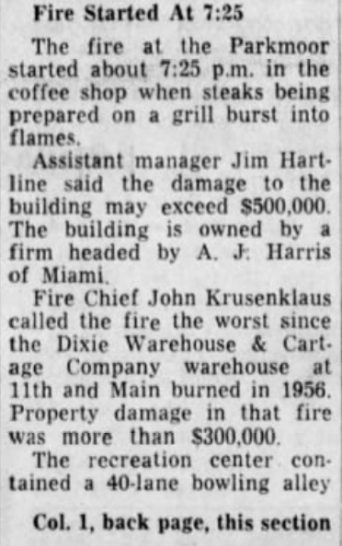
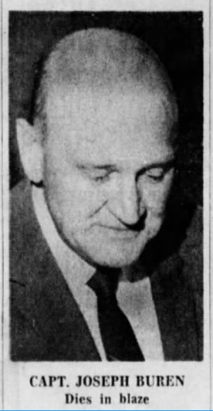

Slide 10
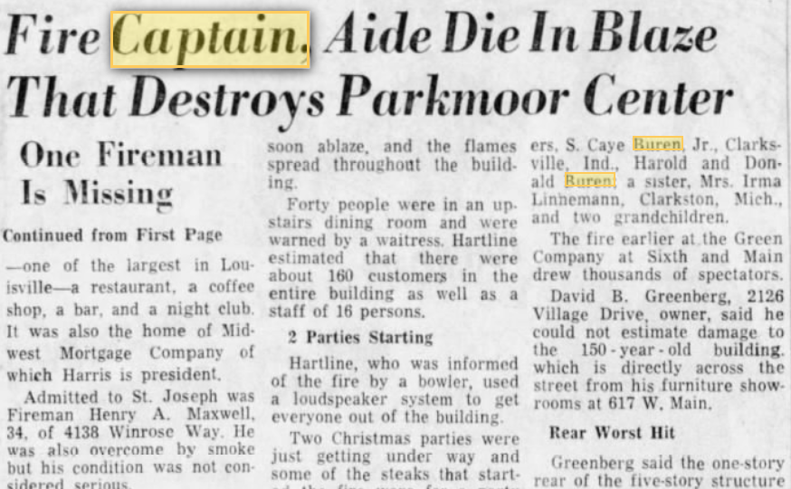
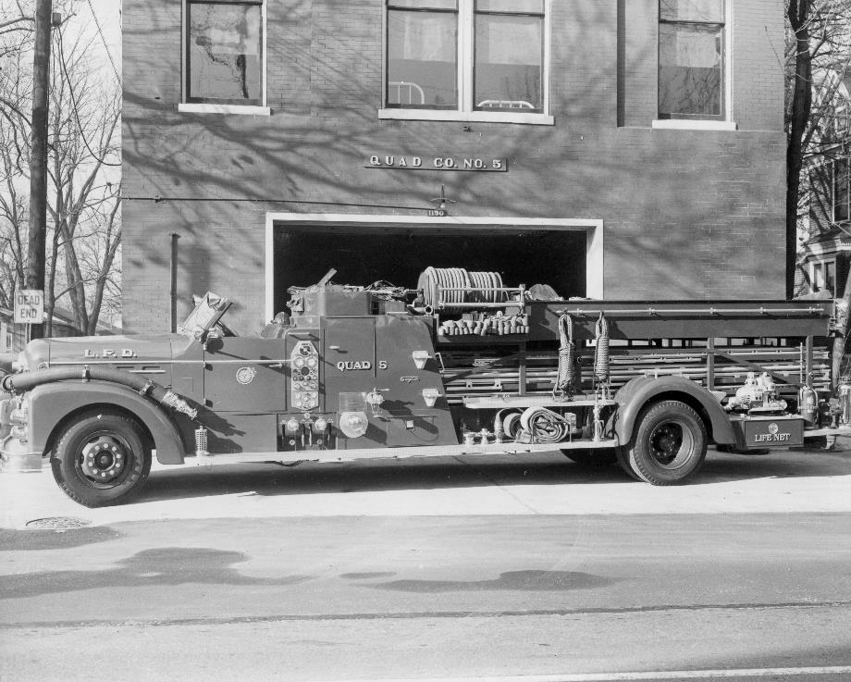
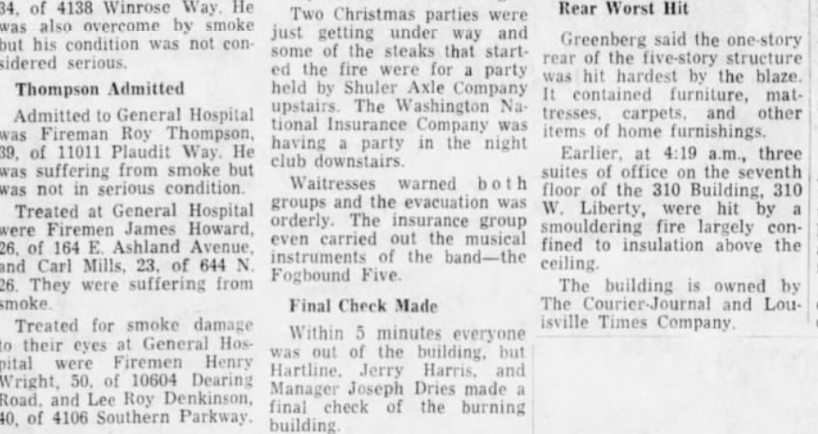

Slide 11
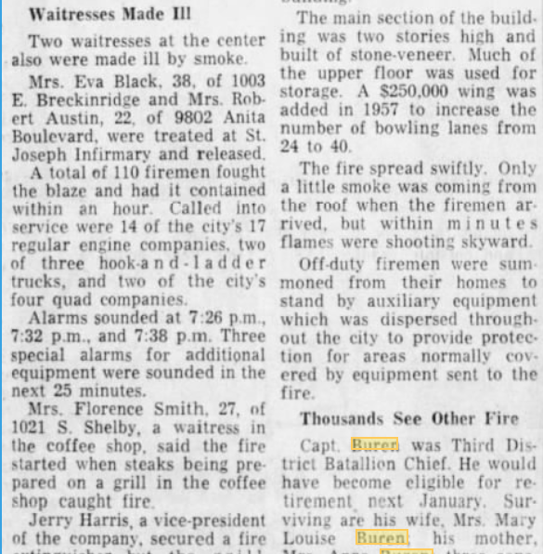
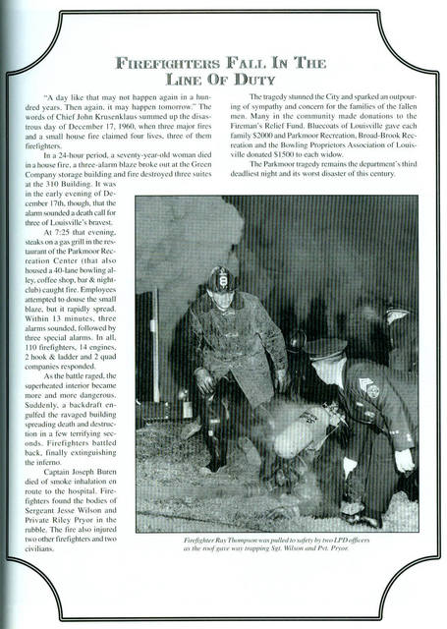
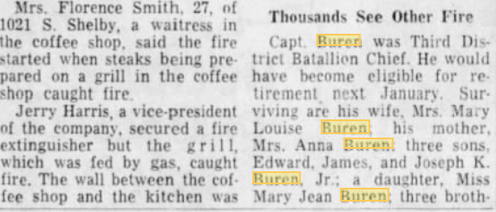

Slide 12
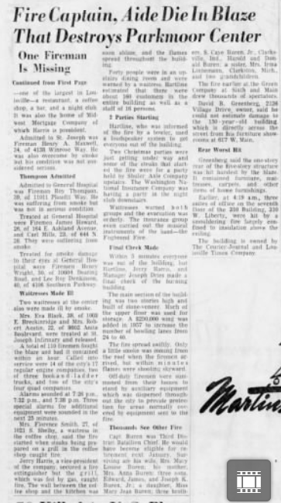
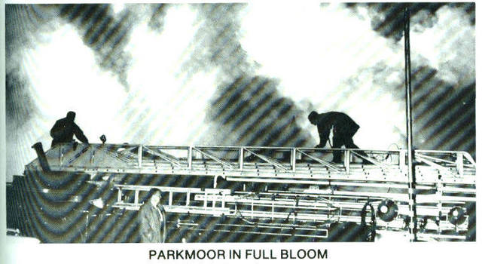

Slide 13
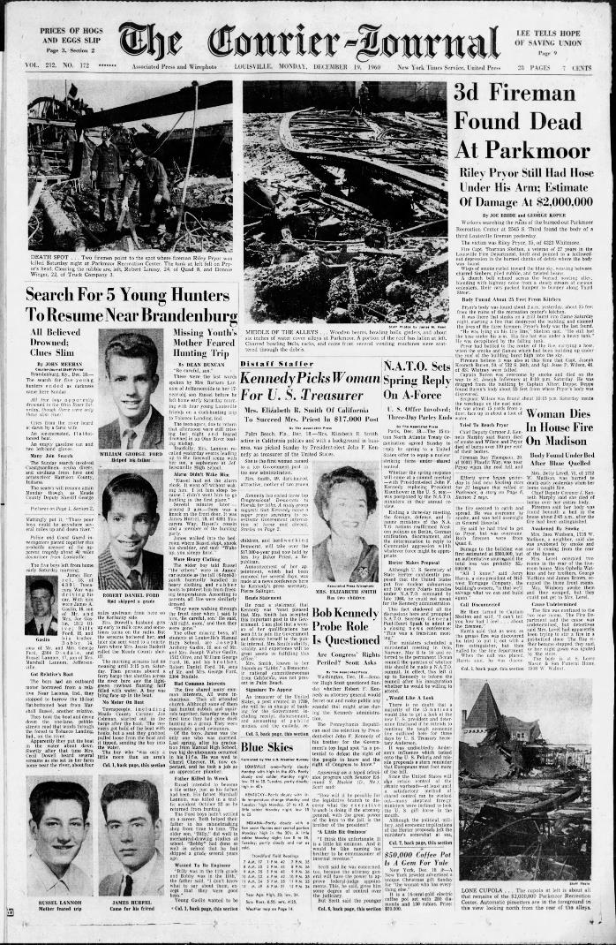
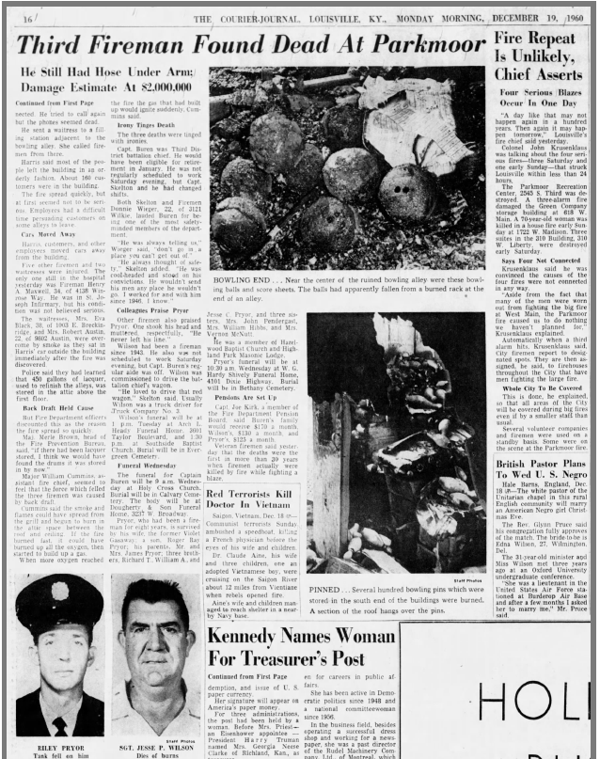
Click on images to expand and read article.

Slide 14
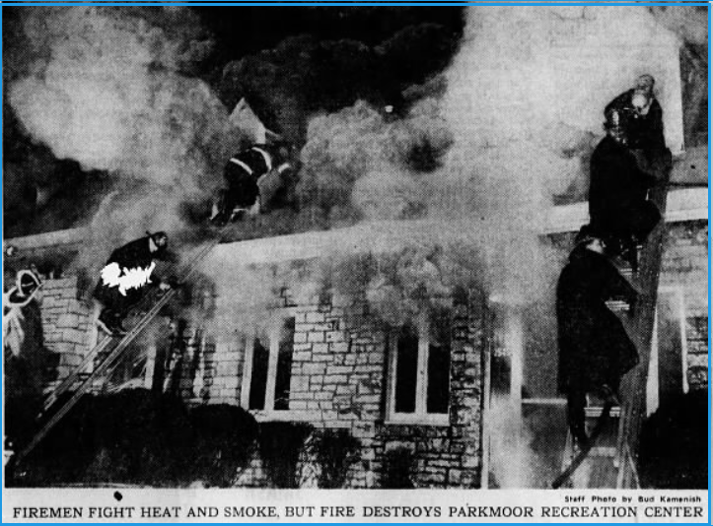

Slide 15
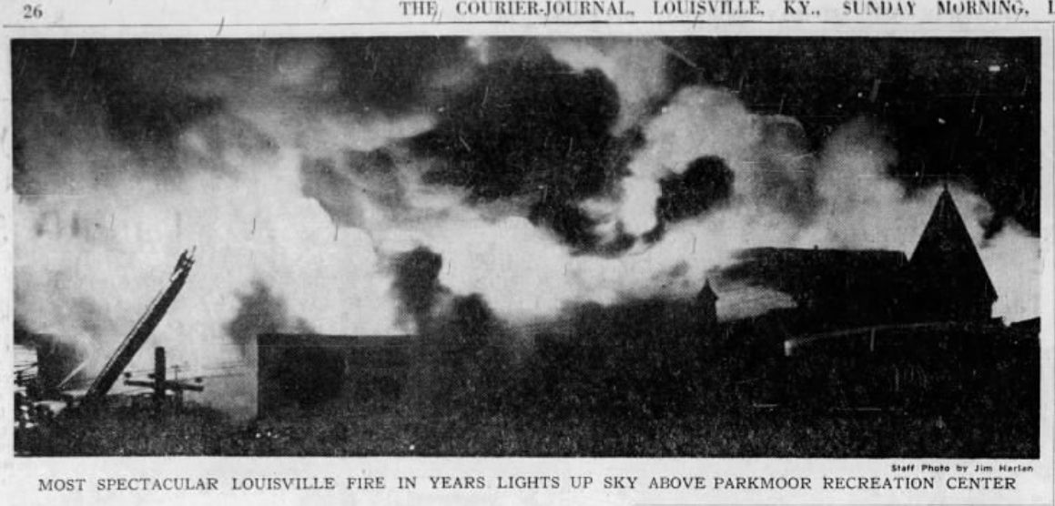

Slide 16
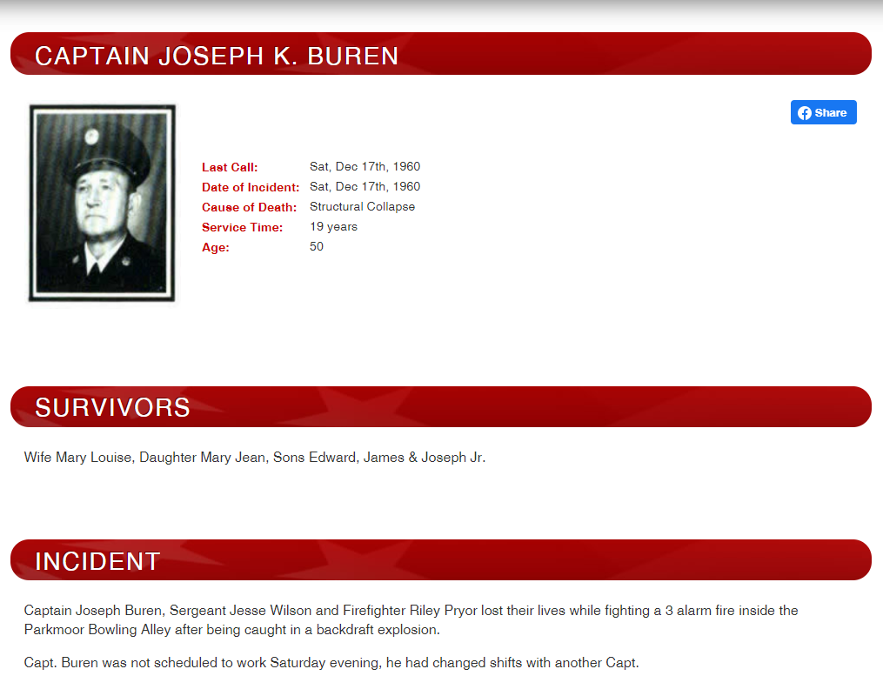

Slide 17
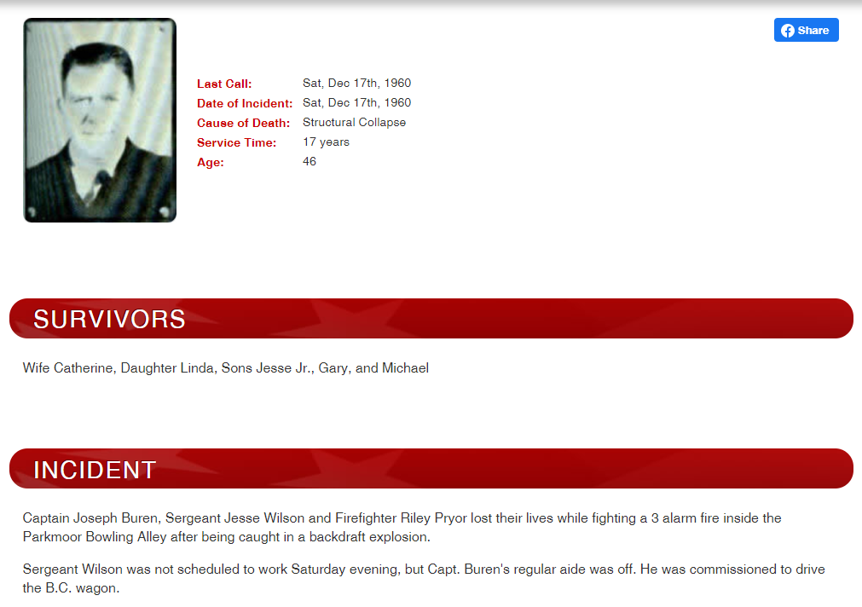

Slide 18
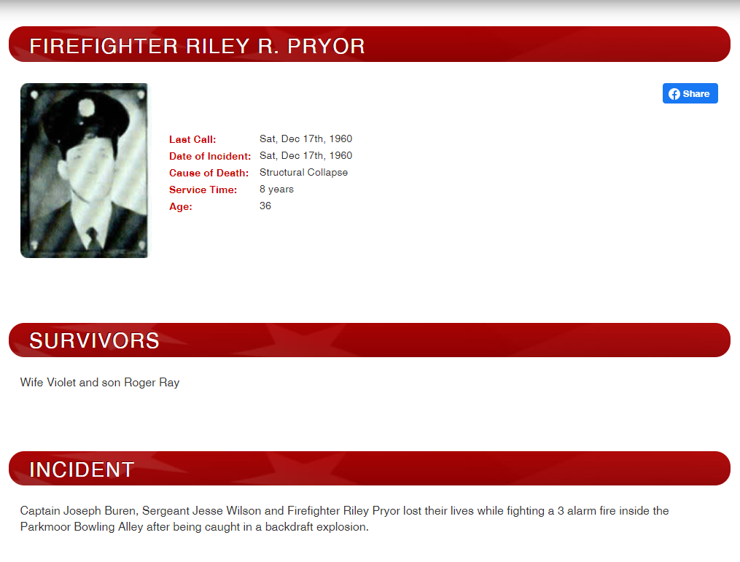

Slide 19
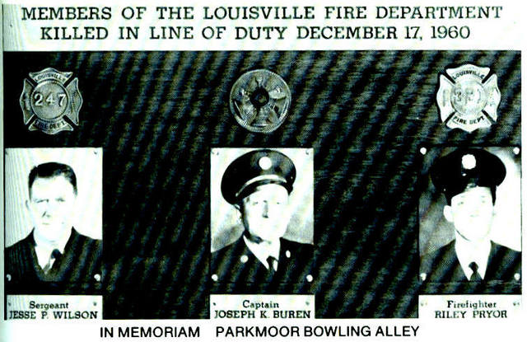

Slide 20

This presentation was produced
as part of the
National Fallen Firefighters Foundation’s
Project Roll Call
honoring fallen firefighters from the memorial park’s Walk of Honor®
Rest in Peace
Captain Buren, Sergeant Wilson and Firefighter Pryor

